Slide 1
Lenz Leopards
Library Lowdown
September 2023
Dates to Remember
November 13 – 17 Scholastics Book Fair
Library Permission slips DUE NOW!
___________________
Reading Celebrations
September 6: “Read a Book Day”
September 25: National Comic Book Day
September 29: National Coffee Day (US)
Library News
Welcome back to school! What an amazing start of the 2023-2024 school year it has been! For those of you new to Lenz, my name is Dawnn Flores, your Lenz Librarian. It is my goal to support literacy and curriculum through school media programs by promoting collaboration, emphasizing information literacy, technology skills, and promoting the love of reading with students, colleagues and the community. We have a lot planned for this year and your child will be immersed in the fun that leads to the
love of reading! If you have any
questions, please do not hesitate
to contact me!
READ ON!
Dawnn Flores, Librarian
Mrs. Flores, Lenz ES Librarian Email address: dlflores@washoeschools.net
2500 Homeland Dr Phone Number: (775) 851-5620 Reno, NV 89511

Slide 2
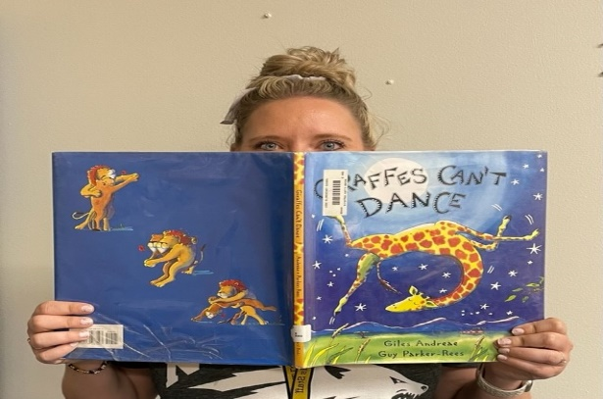
Library Stats
Our library has…
4,102 Fiction Books
2,742 Picture Books
6,370 Non-Fiction Books
477 Graphic Novels
659 Transitional Books
793 Biographical Books
590 Kinder Books
PLUS 100 + new titles
WOW!!
Book Recommendations
PICTURE BOOKS
The Sour Grape by Jory John
(The Sour Grape 🍇 Kids Books Read Aloud – YouTube)
Enemy Pie by Derek Munson
(Enemy Pie by Derek Munson – YouTube)
FICTION BOOKS
The One and Only Ivan by Katherine Applegate
The Dragon Girls (series) by Maddy Mara
The Batboy by Mike Lupica
Staff Reader of the Month
What Staff member is this? Write your guess on a piece of paper and give it to Mrs. Flores in the library. All correct answers will be put in a drawing for a chance to win a free book.
Favorite Book: Giraffes Can’t Dance
by Giles Andrea
Book Quote: “We all can dance, when we
Find music that we love”.
Moral: Accept that we are all different &
We can build courage & self-esteem.
Library Humor
Q: Why does an elephant use its trunk as a bookmark?
A: Then she NOSE where she stopped reading!!

